Slide 1


gd
New Phone. Who’s This?
An Analysis of Cell Phone Features and Their Relationship With Pricing

Slide 2

Why Study Cell Phone Features?
Used by a Majority of People
Technological Advances
Need to Find Best Value for Phone
Consumer Purchasing Power
Cost to Manufacturers
Ability to Change Lives
Lil Nas X and Tiktok
This Photo by Unknown Author is licensed under CC BY-NC

Slide 3

Related Work
Nivitus²
Pandemic Phone Pricing
Minimal Attributes
No Error Testing
Al-Shawwa, Abu-Naser and Nasser³
Neural Network
Difficult Interpretability
We Want the Opposite
Asim and Khan⁴
Naïve Bayes and Decision Tree Classifiers
Inflation Ignored

Slide 4

Proposed Work: Tools and Data Attribute
Cell Phone Hardware
Battery Power
Blue
Clock Speed
Dual Sim
Front Camera
4G
Internal Memory
Mobile Depth
Mobile Weight
Number of Cores
Primary Camera
Pixel height
Pixel Width
RAM
Screen Height
Screen Width
Talk Time
3G
Touch Screen
Wifi
Price Range (Response)
Analysis Using Python
Data Set
Absihek Sharma
Kaggle

Slide 5
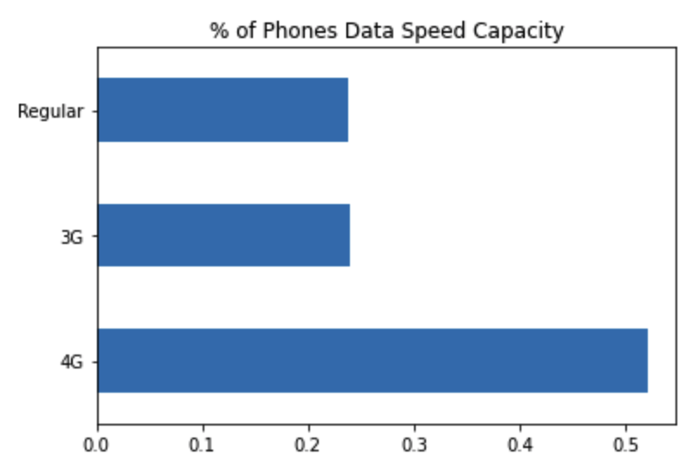
Data Understanding
Overview
2000 Observations
14 Continuous and 7 Categorical Variables
7 Binary Categories
Response Variable
Price Range
Low
Below Average
Above Average
high
500 Each
Data Speed Capacity (Graph on Right)
Uneven Levels
Split 70/10/20 for train, validation and tests set
Metric: Accuracy
Want to be as accurate as possible
Warehousing
Two csv files

Slide 6
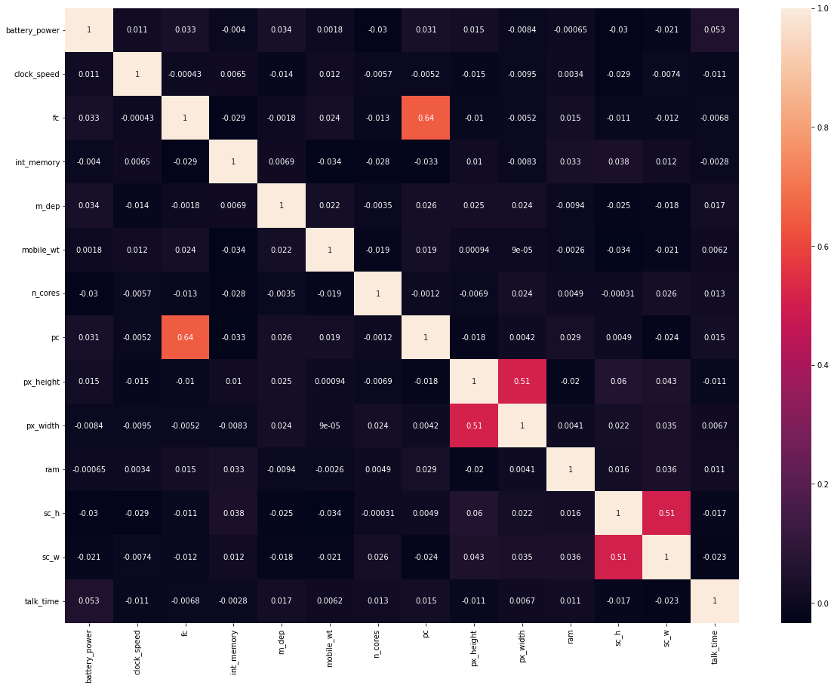
Continuous Correlation
Front Camera and Primary Camera Highly Correlated
Makes sense for both Cameras to be Similar Quality
Pixel Width and Pixel Height
Expected Correlation

Slide 7
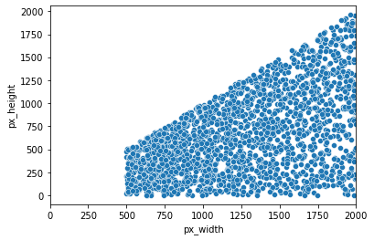
Pixel Height and Pixel Width
Minimal Pixel Width is 500
Height <= Width
Usual Pixel Resolution
1280 x 1024
1920 x 1080
2560 x 1440

Slide 8
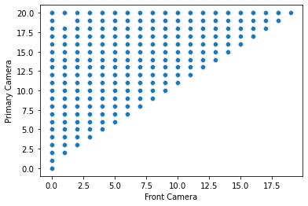
Primary Camera vs Front Camera
Primary Camera >= Front Camera
Confirms hypothesis Primary Camera > Front Camera

Slide 9
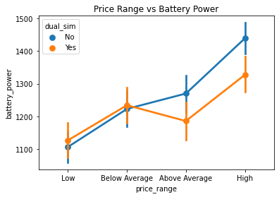
Price Range vs Battery Power
Important, regardless of location
Dual Sim Cards less Prevalent in Higher Priced Devices
Smart Phones Store Data without Sims
Higher Prices = More Battery Power
Lower Prices = Less Battery Power

Slide 10
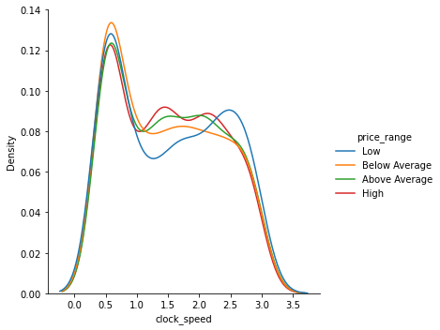
Price Range and Clock Speed
Hypothesis: Higher Priced Phones Have Higher Clock Speed
Low Prices = faster speed
Other Prices Are Similar Speeds

Slide 11
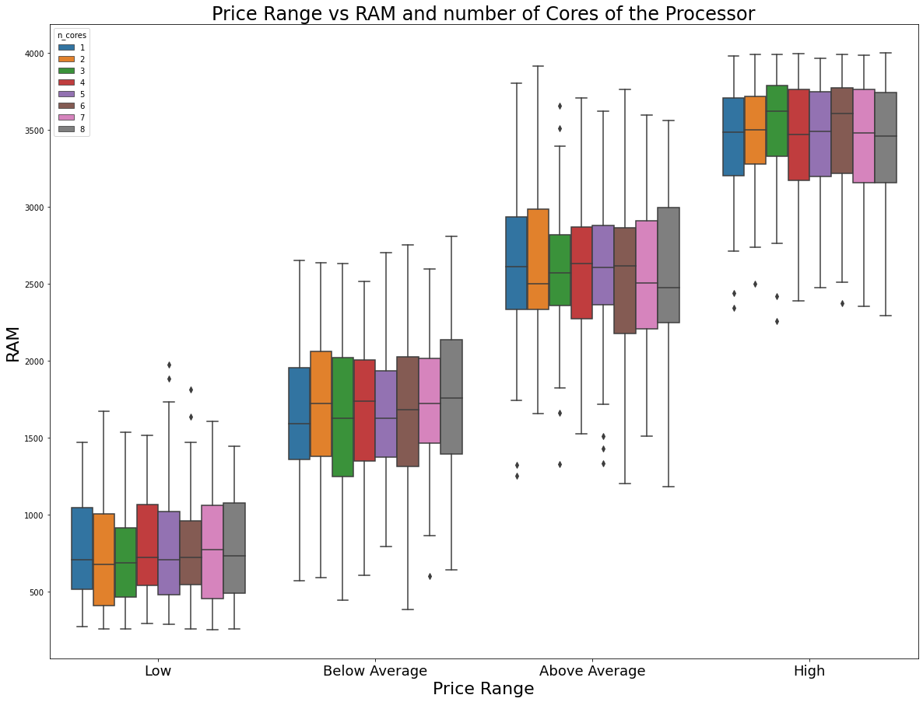
Price Range vs RAM and Core #
Hypothesis: Higher RAM = More Processors and Expensive Phone
Visualization Shows No Relationship Between RAM and Processor Count
The higher the prices, the more RAM

Slide 12
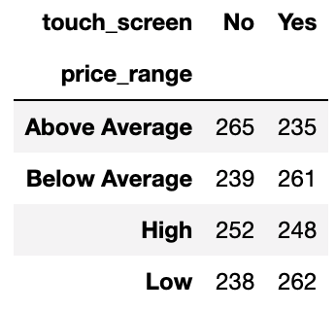
Price Range and Touch Screen Capability
Hypothesis: Touch Screen = Expensive Phone
Hypothesis Test
H₀: Price Range and Touch Screen Capability are independent
H₁: Price Range and Touch Screen Capability are not independent.
P-Value: 0.27
Independent

Slide 13
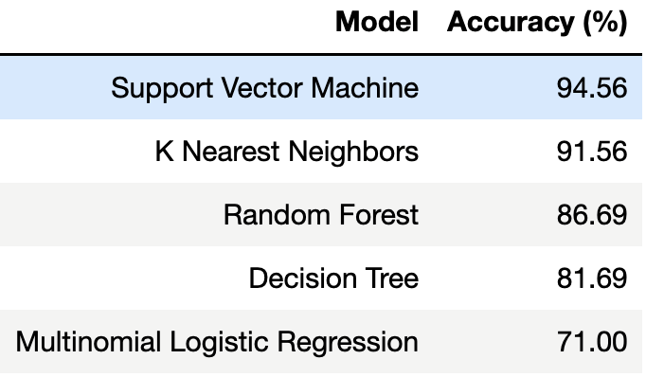
Model Training and Candidates
Experimental Method
Training Set: 70%
Validation Set: 10%
Test Set: 20%
Accuracy: Best Measurement
Expensive Phone Deters Consumer and Manufacturer
Inexpensive Phone loses profits
Model Chosen: Random Forest
Best Interpretability
High Accuracy

Slide 14
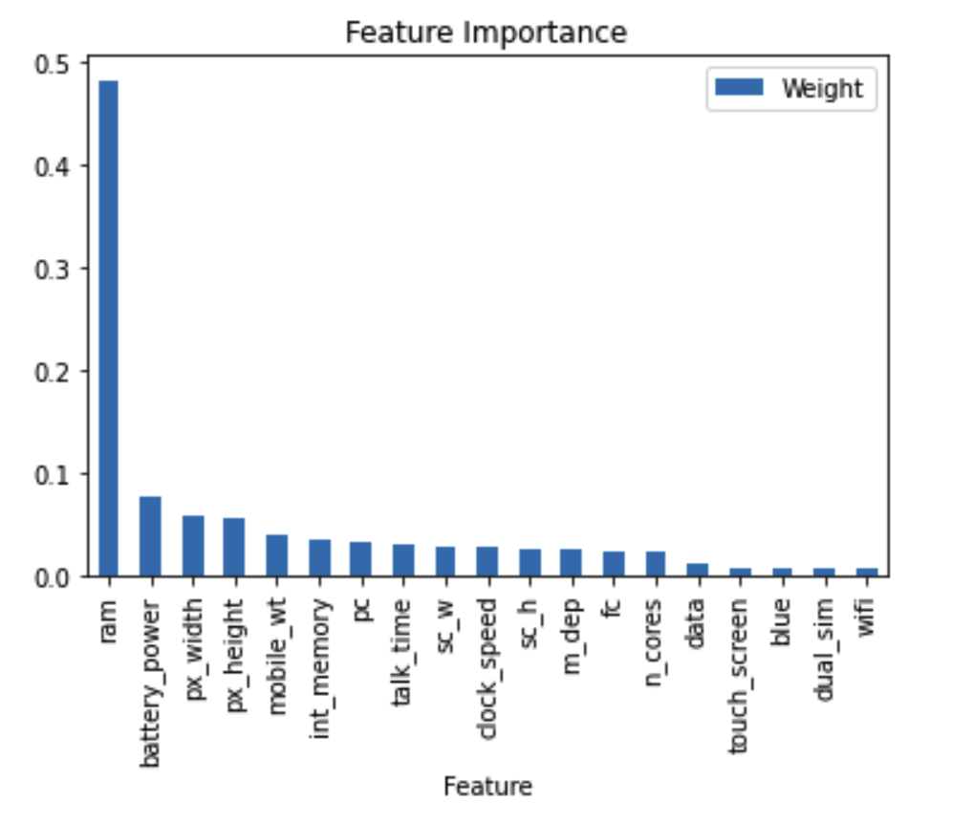
Feature Importance
Random Access Memory (RAM)
Most Important
Battery life and Pixel Dimensions contribute a lot
Less charging
More Mobility
Dropped Features from Model
Data Speed
Touch Screen Capability
WIFI
Bluetooth
Dual-Sim

Slide 15
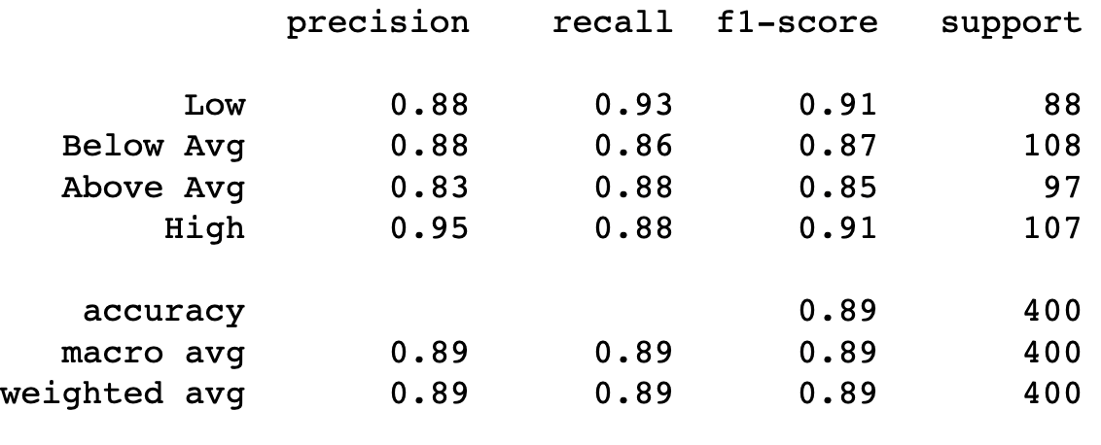
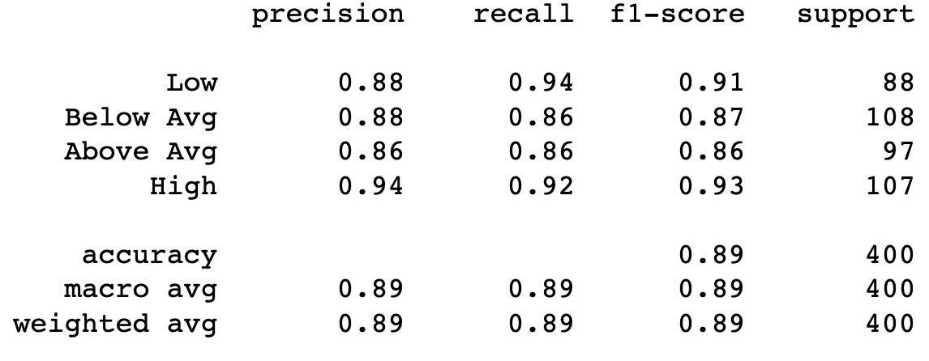
Validation Set Test
Before Hyperparameter Tuning
Accuracy: 89%
Hyperparameter Tuning: GridSearchCV
bootstrap: True
criterion: Entropy
max_Depth: 10
min_samples_split: 5
n_estimators: 500
Precision and Recall Improvement
After Hyper Parameter Tuning

Slide 16
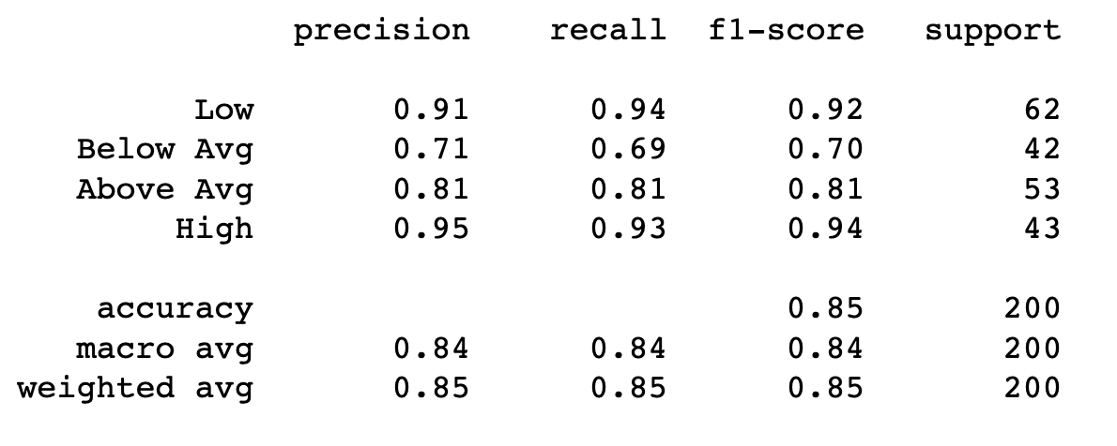
Final Model
Accuracy Decreased a small amount
Minimal Overfitting
Low Precision/Recall: Below-Avg
F1 score
Class imbalance issue?
Indistinguishable below-avg and above avg?

Slide 17
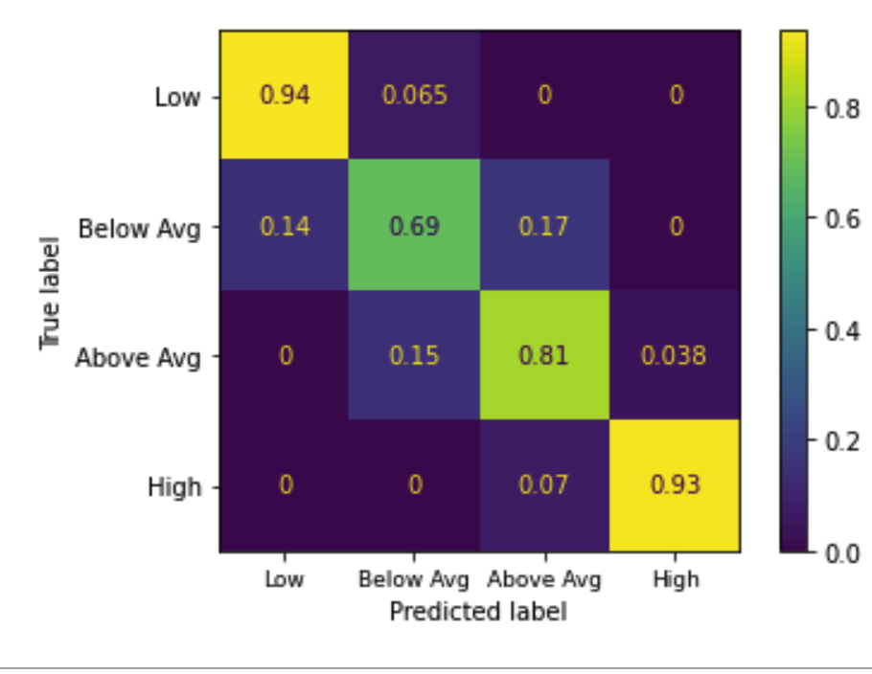
Evaluation
Below average not as accurate
Below Avg and Above Avg mistaken for each other
Too Many Similarities?

Slide 18

Discussion
Timeline Completed
January 17: Have Proposal Completed
January 24: Have all data collected
February 2: Finish Cleaning and Combining Datasets
February 15: Finish all Preprocessing and Outstanding Visualizations
February 19: Finish Comparing Potential Models
February 22: Tune Final Model and Test
February 27: Submit project with presentation
Challenge: Time
Completed within 8 week
Would like more features
Future work
Brand
Temporal Changes
Software

Slide 19
Conclusion
Cell Phone Evolution
Customers and Manufacturers Need Smart Decisions
Best Value

Slide 20
References
[1] G., Deyan. (2022, February 6). How Much Time Does The Average American Spend on Their Phone in 2022?. Techjury. https://techjury.net/blog/how-much-time-does-the-average-american-spend-on-their-phone/#gref
[2] Nivitus. (2020, July 22). Mobile Price Prediction Using Machine Learning. Medium. https://medium.com/@Nivitus./mobile-price-prediction-using-machine-learning-fa9cab6fb242
[3] Al-Shawwa, Mohammed; Abu-Naser, Samy S. and Mohammed Nasser, Ibrahim. (February 2019). Developing Artificial Neural Network for Predicting Mobile Phone Price Range. ResearchGate. https://www.researchgate.net/publication/331398317_Developing_Artificial_Neural_Network_for_Predicting_Mobile_Phone_Price_Range
[4] Asim, Muhammad and Khan, Zafar. (2018, March). Mobile Price Class Prediction Using Machine Learning Techniques. Towards Data Science. https://www.ypulse.com/article/2019/10/01/how-gen-z-millennials-are-discovering-music-on-social-media-in-2-charts/
[5] Zeman, Eric. (2020, July). Phone Prices Have Almost Doubled Over the Past Five Years. Why is That?. Android Authority. https://www.androidauthority.com/how-smartphone-prices-have-changed-1134574/
[6] Sharma, Abhishek. Mobile Price Classification. Kaggle. https://www.kaggle.com/iabhishekofficial/mobile-price-classification

